Slide 1






ATLIQ HARDWARE
FINANCE AND SUPPLY CHAIN ANALYSIS

Slide 2
PROBLEM STATMENT
AtliQ Hardware is Consumer Goods Electronics Company renowned for its global presence, specializes in manufacturing PC’s, Printers, Mouse, Laptops and Desktops.
The increase size of Excel files has resulted in performance issues, causing delays and inefficiencies. AtliQ Hardware has initiated a project to address this challenge, forming a team od data analysts. Leveraging MYSQL as the database management system, the team aims to extract valuable insights from the data. These insights will empower the company to improve decision-making and the streamline operations, leading to enhanced overall performance.

Slide 3
PROJECT OVERVIEW
This project aims to analyze and derive valuable insights from the provided database.
Encompassing sales, Products, customers, and regions data for AtliQ Hardware. The Objective is to Address specific inquires regarding sales report, market analysis, customer behavior and supply chain forecasting.

Slide 4
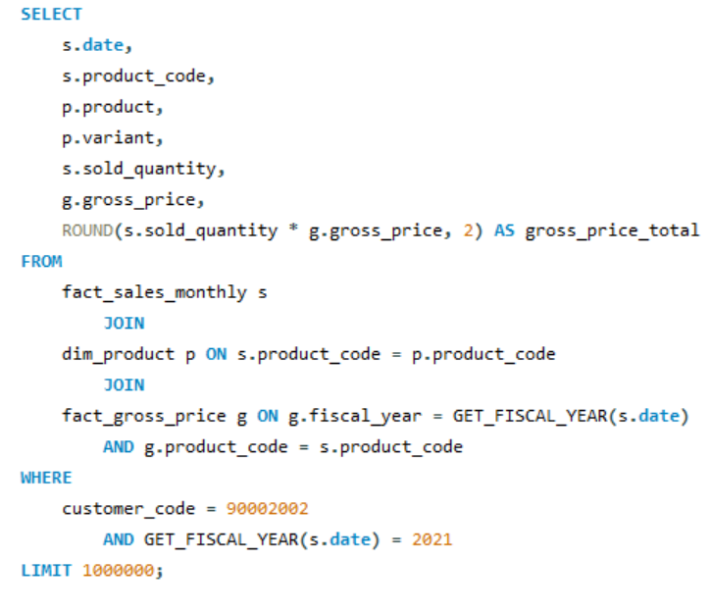
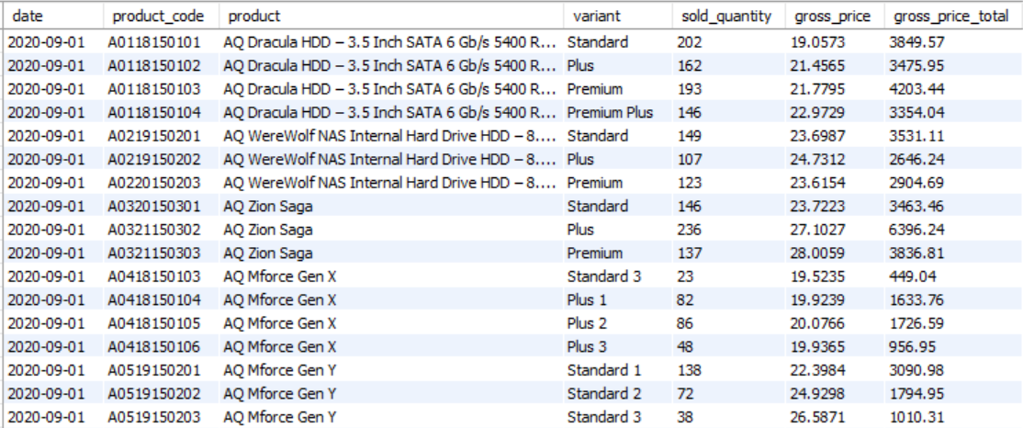
2021 sales Report for Chroma categorized by Product

Slide 5
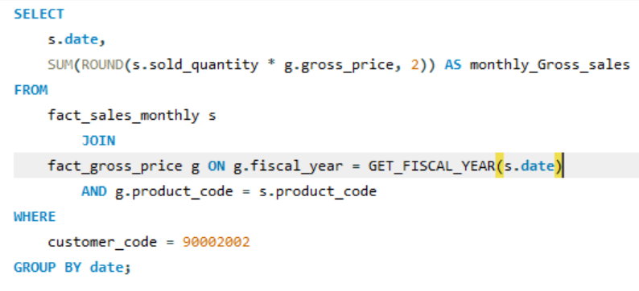
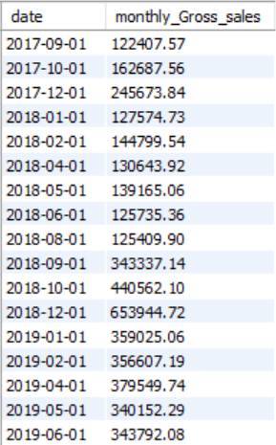
Monthly total gross Sales Report for Chroma

Slide 6
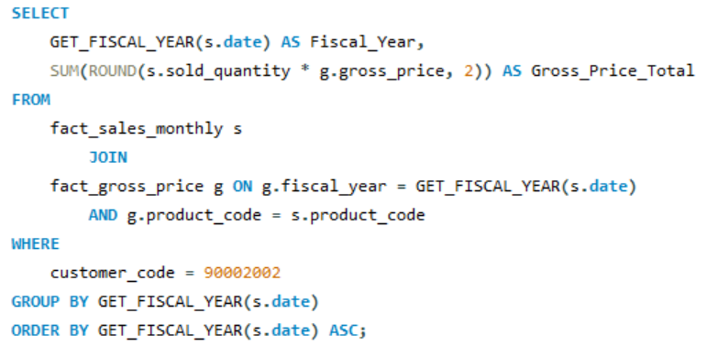
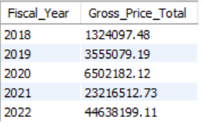
Annual Gross Sales Report for Chroma India

Slide 7
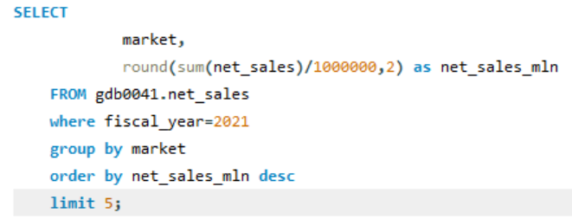
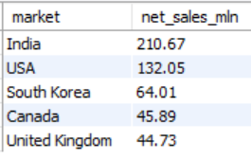
Key Markets in the Financial Year-2021

Slide 8
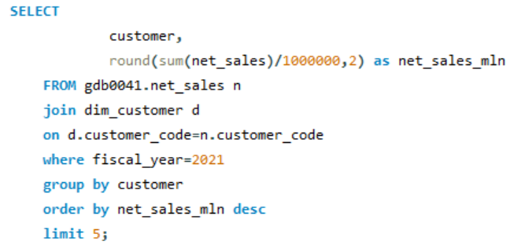
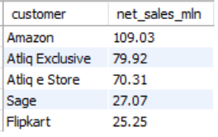
Key Customers in the Financial Year-2021

Slide 9
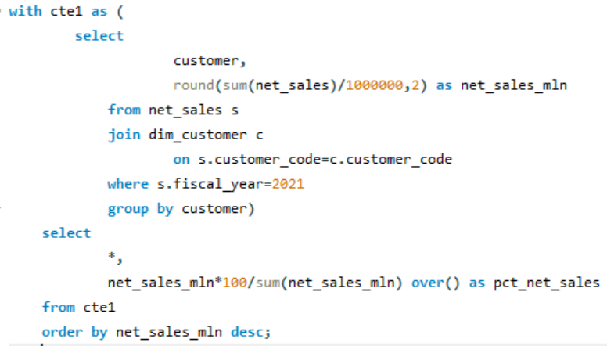
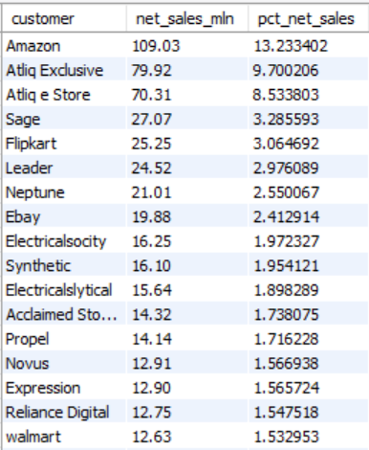
% of Net Sales Contributed by Customers in Market Share

Slide 10
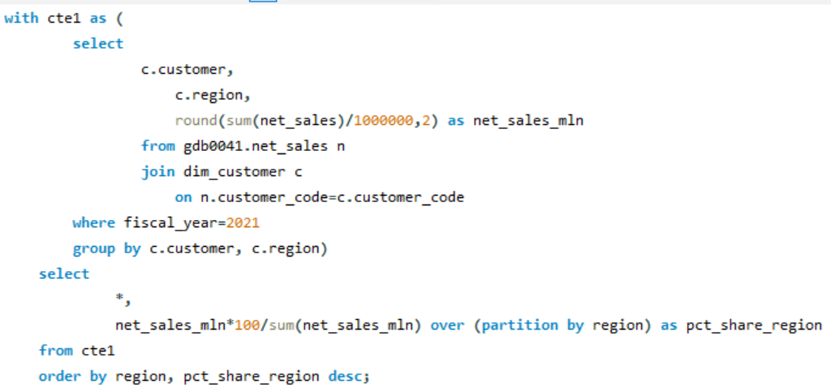
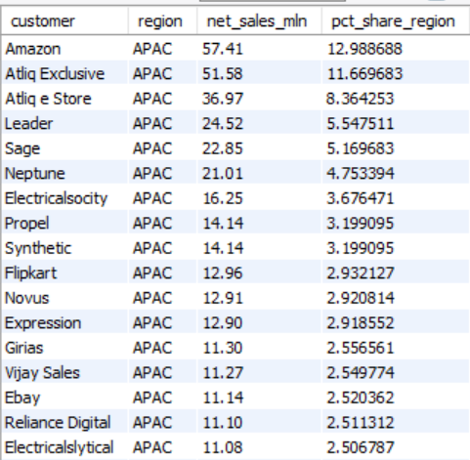
% of Net Sales Contributed by Region Basis in Market Share

Slide 11
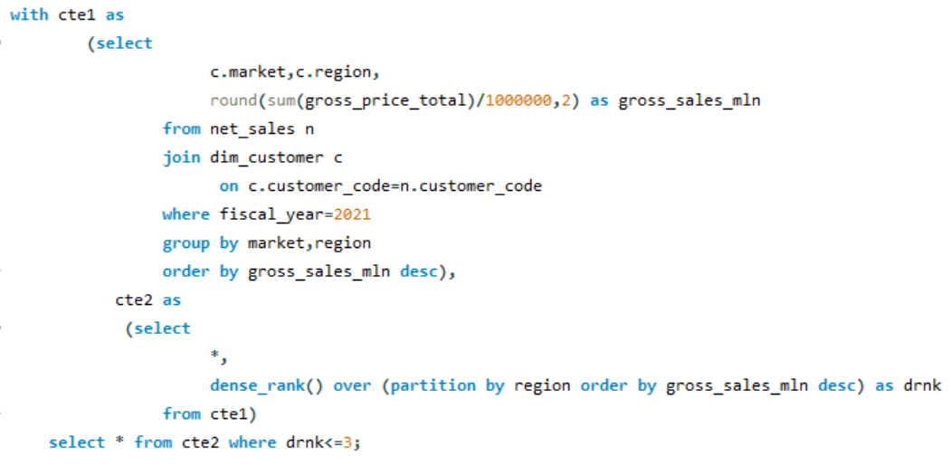
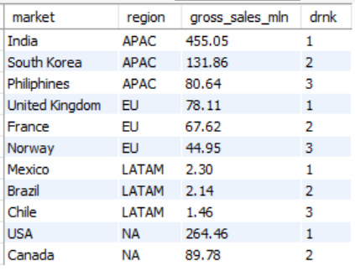
Top 2 Markets of Highest Gross sales in Each Region

Slide 12
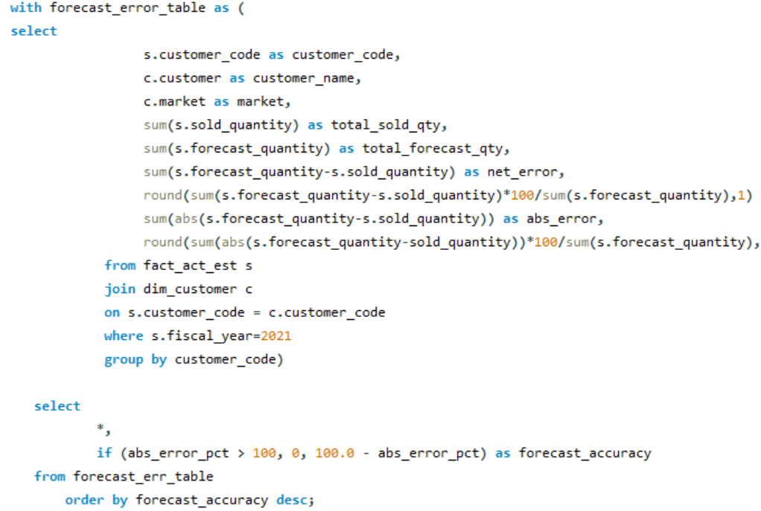
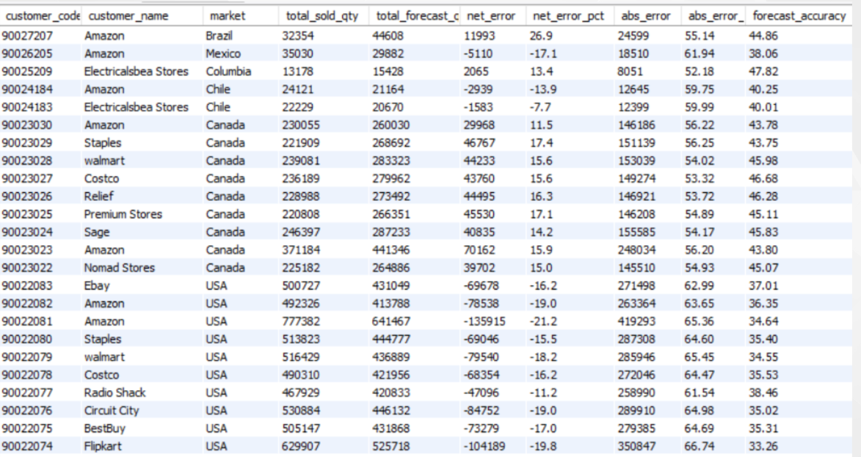
Supply chain – Forecast Quantity

Slide 13
Conclusion
Market in India generated maximum net sales with 210.67M in fiscal year 2021 followed by USA with 132.05M.
Amazon generated 13.23% of total net sales among all customers in fiscal year 2021.
Net sales of Amazone is highest with 109.03 in fiscal year 2021 followed by AtliQ Exclusive with 79.92M.
In APAC region, Amazon contributed maximum net sales % of 12.99% among rest customers in 2021.
India secures the top spot in total gross sales within the APAC region.

Slide 14
Thank you

